Slide 1

Group-2
Group Members:
Rafiz Imtiaz 011183088
Rabeya Hossain Tisha 011171276
Tahmina Rahman Dipty 011183095
Imran Hossain Tushar 011171244
Md. Sabit Hassan Alvee 011183065

Slide 2
Index:
Software Engineering Methodology
1.1 Incremental
1.2 Spiral
1.3 Scrum
1.4 RUP
1.5 eXtreme programming
WBS
2.1. What is WBS?
2.2. Principles of WBS.
2.3. Rules of Decomposition
2.4: WBS of project
2.5 Project Estimation
2.6 WBS checklist
Delphi Method
3.1 Steps of delphi method
3.2 Purpose, Advantages & Disadvantages
3.3 Delphi method of project
4. The reason behind choosing an estimation method.
5. Vision & Scope
5.1 Vision & Scope of project
6. Risk Management
6.1 Risk Management Plan
6.2 Risk Mitigation, Monitoring, and
Management.
6.3 Risk Plan Script
6.4 Risk Plan of project & Table

Slide 3
Methodology
A software development methodology in software engineering is a framework that is used to structure, plan, and control the process of developing an information system.

Slide 4
5 Methodology
Jupiter is the biggest planet of them all
Incremental Methodology
Spiral Methodology
Scrum Methodology
RUP Methodology
Extreme Programming

Slide 5
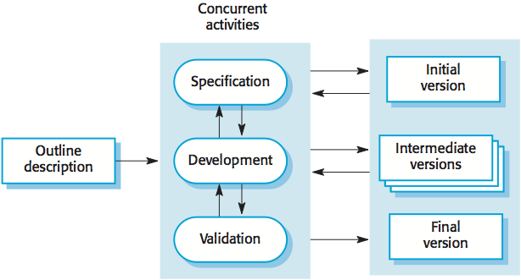
Incremental Methodology
Incremental Model is a process of software development where requirements divided into multiple standalone modules of the software development cycle.
Used in a project has a lengthy development schedule and the requirements are superior.

Slide 6
Incremental Methodology
Advantage
The cost of accommodating changing customer requirements is reduced.
It is easier to get customer feedback on the development work that has been done.
Disadvantage
The process is not visible.
System structure tends to degrade as new increments are added.

Slide 7
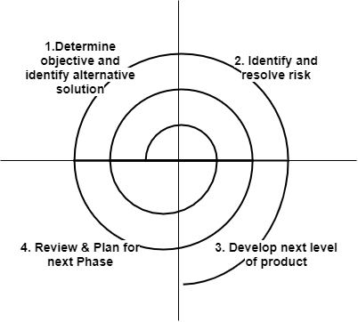
Spiral Methodology
Risk-driven process model.
Used when requirements are unclear and complex
Large and high budget projects
Used in a large project where deliverance is required to be frequent.

Slide 8
Spiral Methodology
Advantage
High amount of risk analysis
Useful for large and mission-critical projects.
Disadvantage
Can be a costly model to use.
Risk analysis needed highly particular expertise
Doesn't work well for smaller projects.

Slide 9
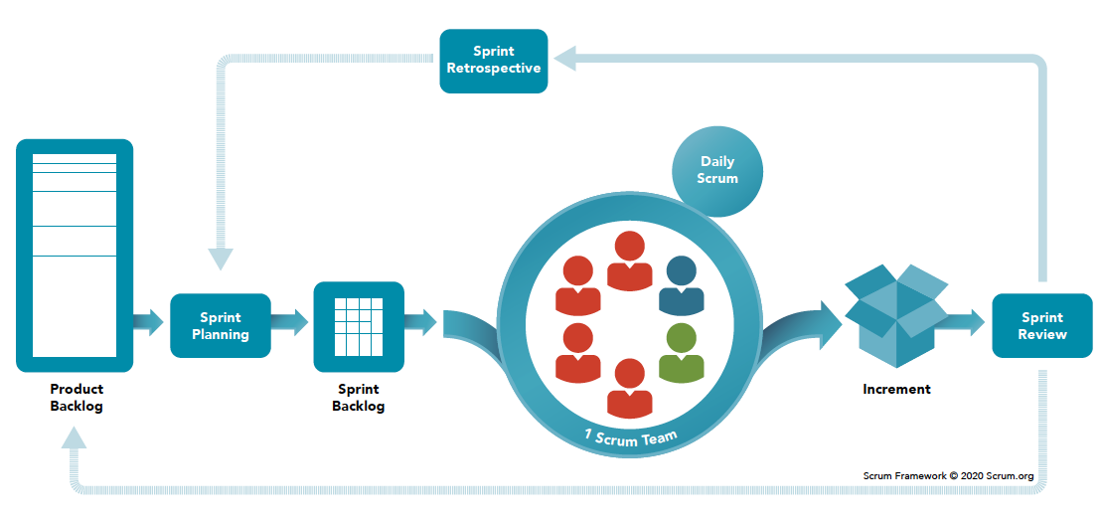
Scrum Methodology
Scrum is adaptable, fast, flexible.
Continuous improvement within cross-functional teams.
Used in the development of Software based on an iterative and incremental processes.

Slide 10
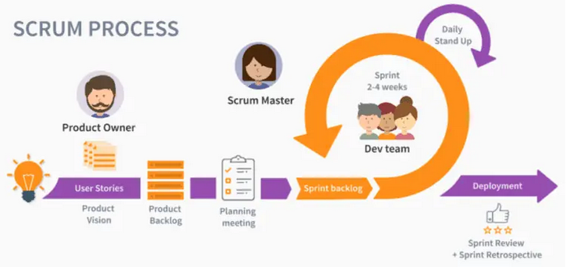
Product owner: Product owner Is the representative of the stakeholders and customers who use the software.
Scrum Master: The Scrum Master is in charge of keeping Scrum up to date, providing coaching, mentoring and training to the teams in case it needs it.

Slide 11
Product Backlog: The product backlog is a list that collects everything the product needs to satisfy the potential customers.
Sprint: Sprint is the basic unit of work for a Scrum team. This is the main feature that marks the difference between Scrum and other models for agile development.

Slide 12
Scrum Methodology
Advantage
Flexibility and adaptability
Enhanced collaboration and communication
Iterative delivery of value
Empowered and self-organizing teams
Disadvantage
Dependency on team collaboration
Unrealistic expectations
Lack of predictability for long-term planning
Limited documentation

Slide 13
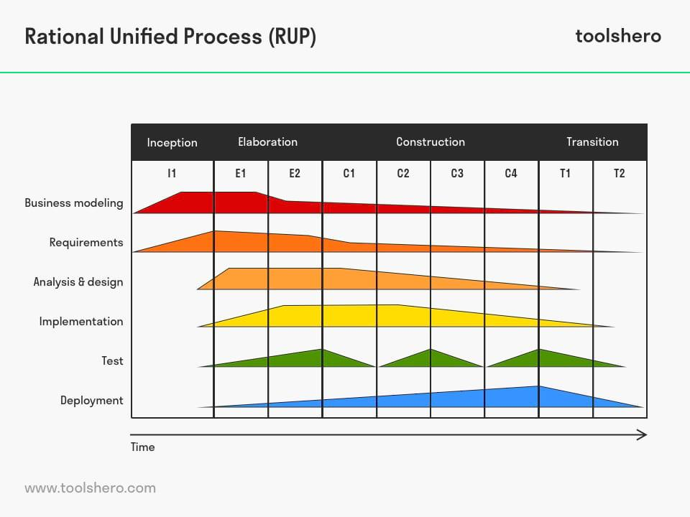
Rational Unified Process(RUP) Methodology
Focuses on four phases
RUP Methodology is an agile software development method
RUP emphasizes iterative development, risk management, and collaboration among stakeholders.

Slide 14
Rational Unified Process(RUP) Mythology
Advantage
Iterative and incremental approach
Strong focus on quality
Well-defined roles and responsibilities
Tailorability
Disadvantage
Complexity
Potentially lengthy development cycles
Overemphasis on documentation
Steep learning curve

Slide 15
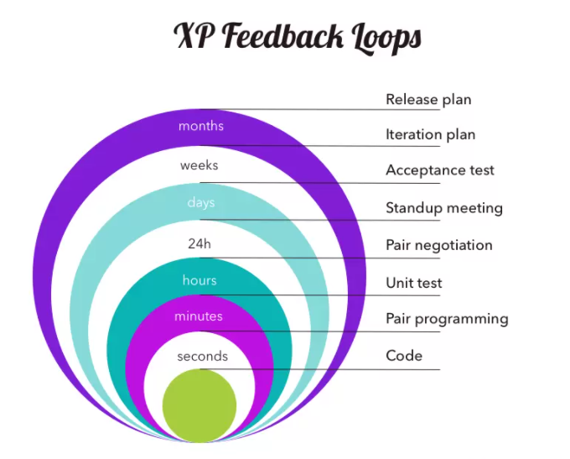
eXtreme Programming Mythology
It is used to improve software quality
Rapidly changing requirements
It focuses on delivering high-quality software through continuous feedback, frequent releases, and customer involvement. XP employs practices such as pair programming, test-driven development, and continuous integration.

Slide 16
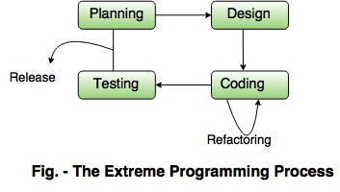
eXtreme Programming Process

Slide 17
Extreme Programming Mythology
Advantage
Quick and frequent delivery of working software
Emphasis on quality through testing
Adaptability to changing requirements
Disadvantage
Dependency on team dynamics
Learning curve and skill requirements
Potential for scope creep
Documentation challenges
Used when the project requirements are likely to change frequently, as XP embraces adaptability and embraces change.

Slide 18
The Incremental Methodology we used for our project Smart Job Portal:
The methodology that we’ve used is ‘Incremental Methodology’ where the scopes have been divided and assigned to different team members.
Each member doing their own Sprint; coding, implementing, and testing individually. And then at the end, everything is merged.
This methodology has been used as the requirements of our system are clear, the team is not experienced and this methodology is mostly used for web-based systems.
This methodology helps us in budget management, working with an inexperienced team, dividing the work properly among team members, and fast product development like no other methodology. That’s why we’ve chosen Incremental software development methodology for our Project.

Slide 19
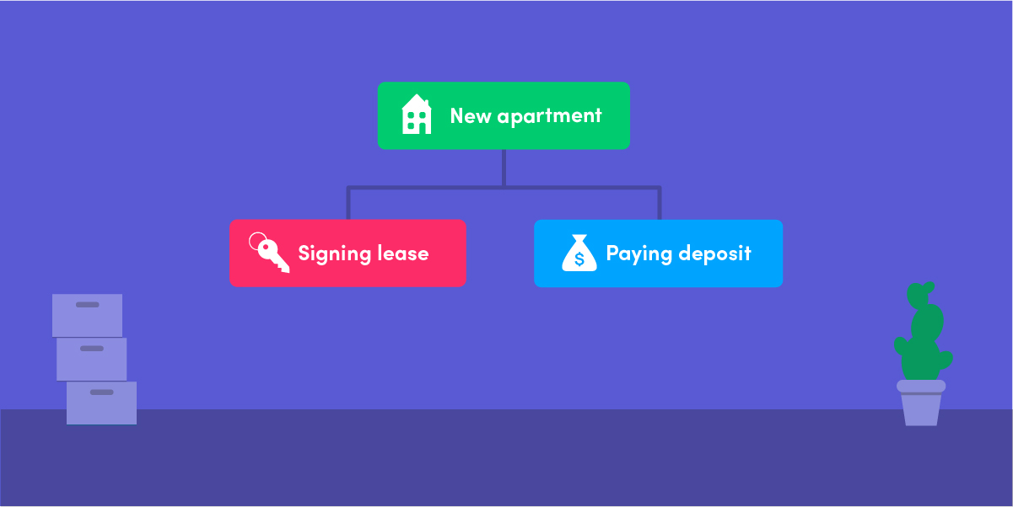
What is Work Breakdown Structures?
Work Breakdown Structures (WBS) is a term used in project management.
PMBOK defines WBS as-“A deliverable-oriented hierarchical decomposition of the work to be executed by the project team to accomplish the project objectives and create the required deliverables”.
It is a visual representation of what has already been done and what should still be done to complete the project.

Slide 20
Work Breakdown Structure (WBS)
The WBS represents a logical decomposition of the work to be performed and focuses on how the product, service, or result is naturally subdivided. It is an outline of what work is to be performed.
LEVEL | ELEMENT DESCRIPTION
1 | Project
2 | Category
3 | Subcategory
4 | Sub-Subcategory
5 | Work Package

Slide 21
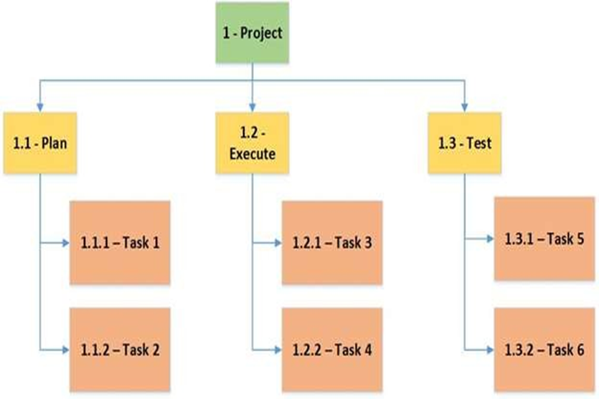

Slide 22
Major Benefits of WBS in Project Management
It helps in estimating the workforce, cost, and time required for project success.
It reduces the delay factor to a large extent.
It smoothens the whole lifecycle of projects.
It makes the job of assigning responsibilities easier.
It streamlines the way of project planning so that the hassle of repeat work doesn’t take place in the later stages.

Slide 23
Types of Work Breakdown Structures
There are two types of work breakdown structures commonly employed in project management:
The process-oriented WBS
Deliverable-oriented WBS.

Slide 24
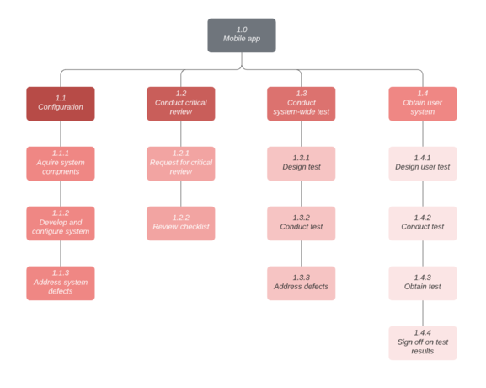
Process-oriented work breakdown structure
A process-oriented WBS defines a project in terms of steps, work phases, or functions. This type of WBS is focused on the steps that need to be taken within individual disciplines to complete a project and typically phrases individual elements in verb form

Slide 25
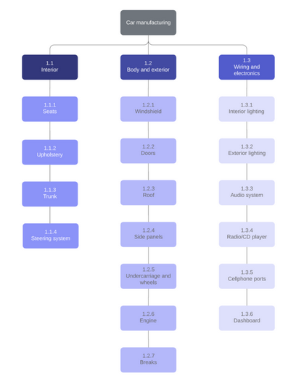
Deliverables-oriented work breakdown structure
A deliverables-oriented WBS defines a project in terms of tangible deliverable components. Deliverables are typically a physical component or item needed to complete the overall project.

Slide 26
WBS Design Principles:
Follow the 100 percent rule:
To eliminate work that doesn’t contribute to the deliverable, ensure that the sum of all resources in WBS, whether time, money, or another element, adds up to 100 percent. In other words, the elements in level two total 100 percent, and the level three and lower elements roll up into the level two percentage. The finished project should never total more or less than 100 percent.
Level 2 is the Most Important
Of all the levels on a WBS, Level-2 is often the most important because it determines how actual costs and schedule data are grouped for future project cost and schedule estimating. A project manager may find it useful to know how much it took to design (major work element) a product after it had been completed.

Slide 27
Focus on deliverables, not methods
The key purpose of a work breakdown structure is to define the main deliverable in terms of the small components that form it. If the deliverable is not a product, then it must provide a specific and measurable outcome.
Mutually-exclusive Elements
A WBS must not have any scope definition overlap between its various componentsthus every single component is independent and unique

Slide 28
The Four Elements in Each WBS Element:
1. The scope of work
2. Time frame
3. Budge frame
4. Responsible HR
The 40-Hour Rule of Decomposition:
Typically, there is no need to further break down a project once each element has around 40 hours(work week) of direct labor committed.
The 4% Rule of Decomposition:
This guideline states that a WBS is sufficiently decomposed when the lowest element represents around 4% of the whole project.

Slide 29
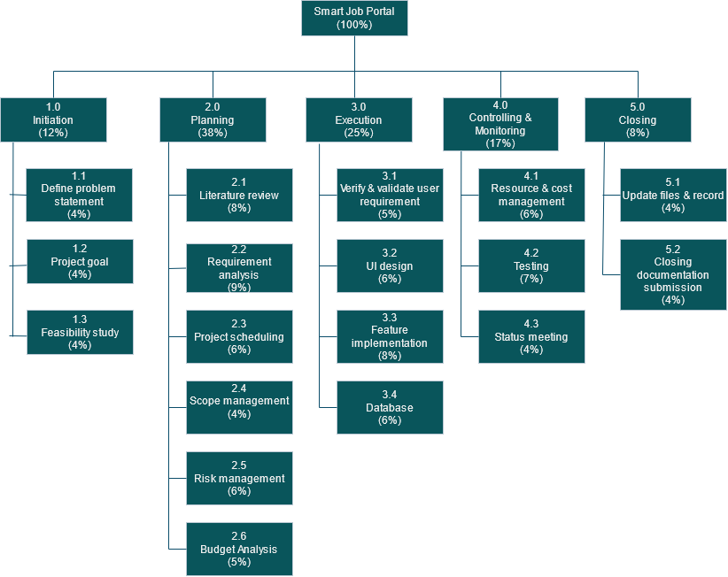

Slide 30
Literature Review (8%)
1. Deliverables:
● Related research
● Gap analysis
2. The beginning and end dates for the scope of work:
Start date: 12-07-23
End date: 19-07-23
3. The budget for the scope of work
Budget = hours of labor x average hourly salary of developers + overhead
= 48 x 320+(48 x 320)= 30720
4. The name of the person responsible for the scope of work: Mr. X

Slide 31
Project Estimation
Project estimation is a method of analyzing data to develop a forecast of the resources, time or budget a team might need to complete a project.

Slide 32
Estimation Techniques
- The Project Management Approach
•Guesstimating
•Delphi Technique
•Time Boxing
•Top-Down
•Bottom Up
•Analogous Estimates (Past experiences)
•Parametric Modeling (Statistical)

Slide 33
WBS Checklist
Checklist:
If it does define 100% of the work that will be produced by the project
If it does each element represent a deliverable
If there are a hierarchical structure used
If it does have a least two levels with at least one level of decomposition.
Is there a hierarchical structure used
If it does allow to estimate costs accurately
The checklist can be used to assure that the project has completed the activities related to an effective Work Breakdown Structure and what if the WBS define 100% of the scope of the project or not.

Slide 34
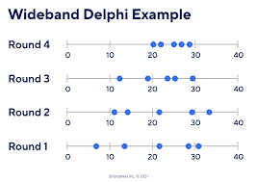
Delphi Wideband
Wideband Delphi Technique is a consensus-based estimation technique for estimating effort.
Useful when estimating time to do a task.
Participation of experienced people and they individually estimating would lead to reliable results.
People who would do the work are making estimates thus making valid estimates.

Slide 35

Steps of Delphi Wideband
Choosing the team
Kick off meeting
Individual preparation
Estimation Session
Assemble tasks
Review result

Slide 36
Purpose and focus of the Delphi method
Expert input: The Delphi method collects input and opinions from a panel of experts.
Iterative process: It involves multiple rounds of feedback and refinement.
Anonymity: Experts provide input anonymously to avoid bias and influence.
Consensus building: The method aims to reach agreement or convergence among experts opinions.
Complex decision-making: It is used for complex or uncertain topics requiring expert judgment.

Slide 37
Advantages:
Varied expertise: Delphi method gathers input from different experts, getting a range of perspectives.
Anonymous opinions: Experts can share unbiased views without being influenced by others.
Consensus through feedback: Multiple rounds help experts refine their opinions and reach agreement.
Disadvantages:
Time-consuming: Conducting multiple rounds of communication takes a long time.
Costly expert gathering: Assembling a panel of experts can be expensive.
Reliability affected by expert availability: Results may be less reliable if experts are not committed.
Limited in-person interaction: Lack of face-to-face meetings can hinder idea sharing.
Potential bias in selection: Biases can arise from how experts are chosen and how results are interpreted.

Slide 38
Delphi method in this project
Using the method we did the project estimation. Using the six steps below we performed the Delphi method:
Step 1: Choose the team:
We have chosen five members for our team, and our moderator is familiar with the Delphi process. 2 team member are part of the estimation team.
Step 2: Kick-off Meeting:
All of our team members have done the research for the background of our project beforehand. Three of our team members had written down assumptions. Rest of the members are assigned to generate WBS with tasks.
Step 3: Individual Preparation:
Team member prepares schedules to do certain tasks, for each task, our five team members wrote down how much time it would take to complete their individual task, some members are given tasks of risk analysis and WBS, so if there is any additional assumptions they need to make for generating new estimations, they will tackle it.

Slide 39
Step 4: Estimation Session:
In this step, first we have come to a consensus on the effort required for each task in WBS. The effort was equally divided. Also, every team member fills out an estimation form individually with his/her estimates. Finally, we have done a discussion season when every member revises their estimates along with group discussion.
Step 5: Assemble Tasks:
In this step, we have collected the estimates from our other team members. Also, we have compiled the final task lists, estimates & assumptions.

Slide 40
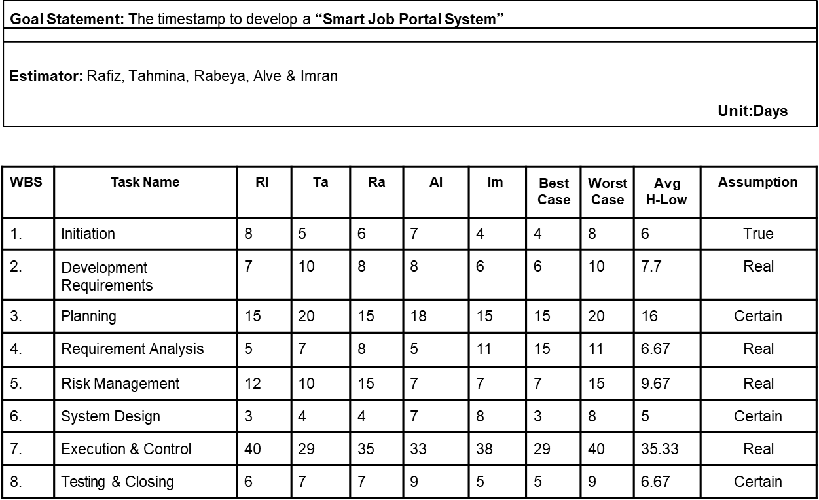
Step 6: Review Results:
Finally, we have reviewed all our final tasks along with the estimation. The result was satisfactory.

Slide 41
Why we are using WBS And Delphi for our project:
Both the Work Breakdown Structure (WBS) and Delphi method can be useful tools for project management, but they serve different purposes and can be applied in different contexts.
Applying the WBS to our project would involve breaking down the major project deliverables into smaller work packages, such as:
User registration and login system
Job posting and management
Candidate profile creation and search
Application submission and tracking
Payment gateway integration
Customer support system
Reporting and analytics
The WBS can help the project team understand the overall project scope, allocate resources effectively, and track progress against specific deliverables.

Slide 42
Delphi Method:
The Delphi method is a structured communication technique used to gather expert opinions and insights. It involves collecting input from a group of individuals anonymously and iteratively. This process continues until a consensus is reached.
We could use the Delphi method to gather expert input on the following aspects:
Determining the most critical features to include in the job portal.
Identifying potential challenges or risks specific to the online job portal domain.
Estimating the market demand and potential user adoption rates.
Evaluating the viability of integrating emerging technologies into the platform.
Work Breakdown Structure (WBS) to organize and manage the project's execution, while the Delphi method can help us to gather expert opinions and insights on critical project aspects. Both methods can complement each other and contribute to the success of our project.

Slide 43
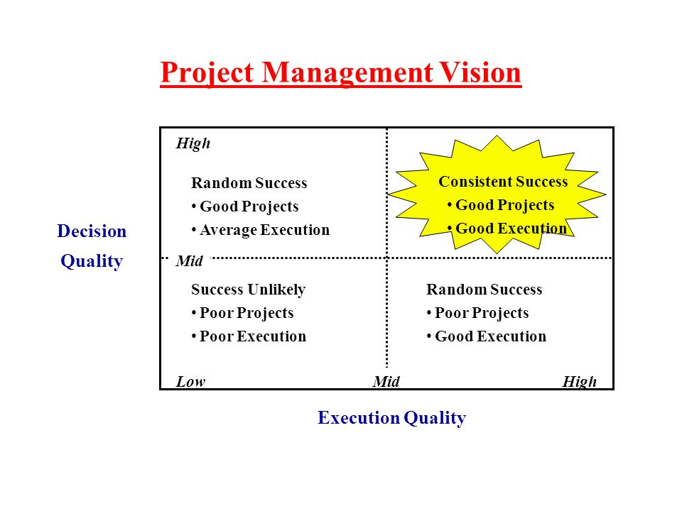
Vision: Project vision is the description of the desired outcome and sets the direction for the project.

Slide 44
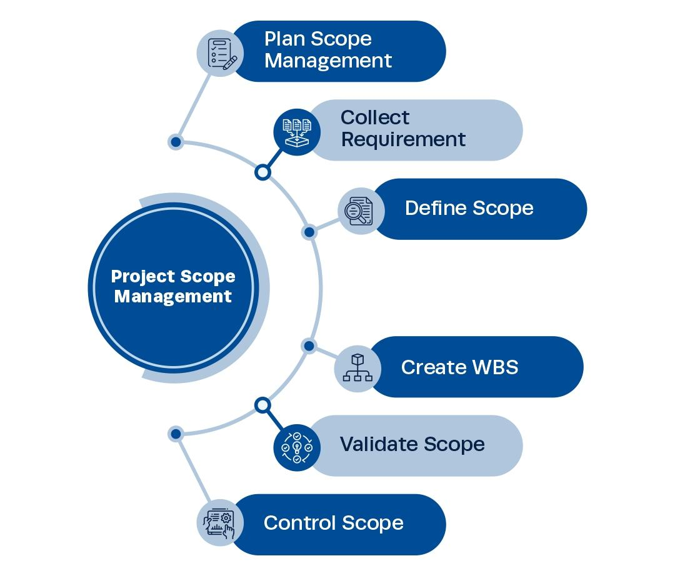
Scope: The project scope is the total amount of work that needs to be done to complete a project.

Slide 45
According to our project:
Vision
Online Job Portal System is developed for creating an interactive job vacancy for candidates. This web application is to be conceived in its current form as dynamic site-requiring constant updates both from the seekers as well as the companies. On the whole, the objective of the project is to enable jobseekers to place their resumes and companies to publish their vacancies.

Slide 46
Scope
Registration
Login
User Dashboard
Job Feed
Search
Post Job
Upload CV
Message
Video Calling
Notification
Company Review

Slide 47
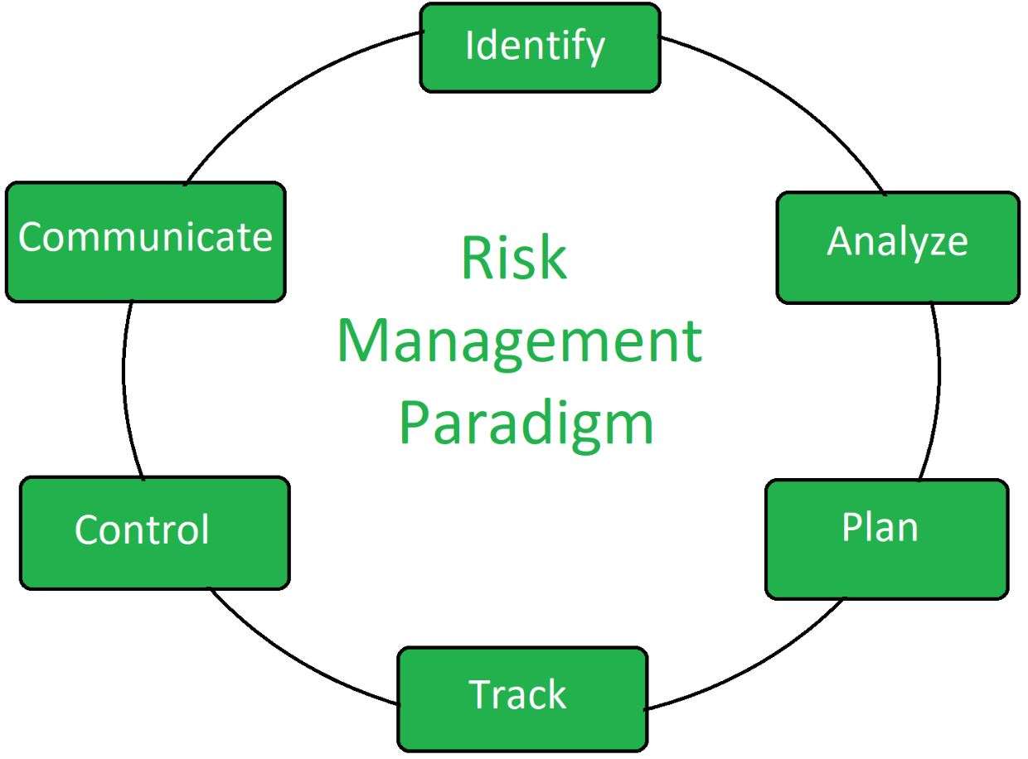
Risk management
Risk analysis and management are actions that help a software team to understand and manage uncertainty.

Slide 48
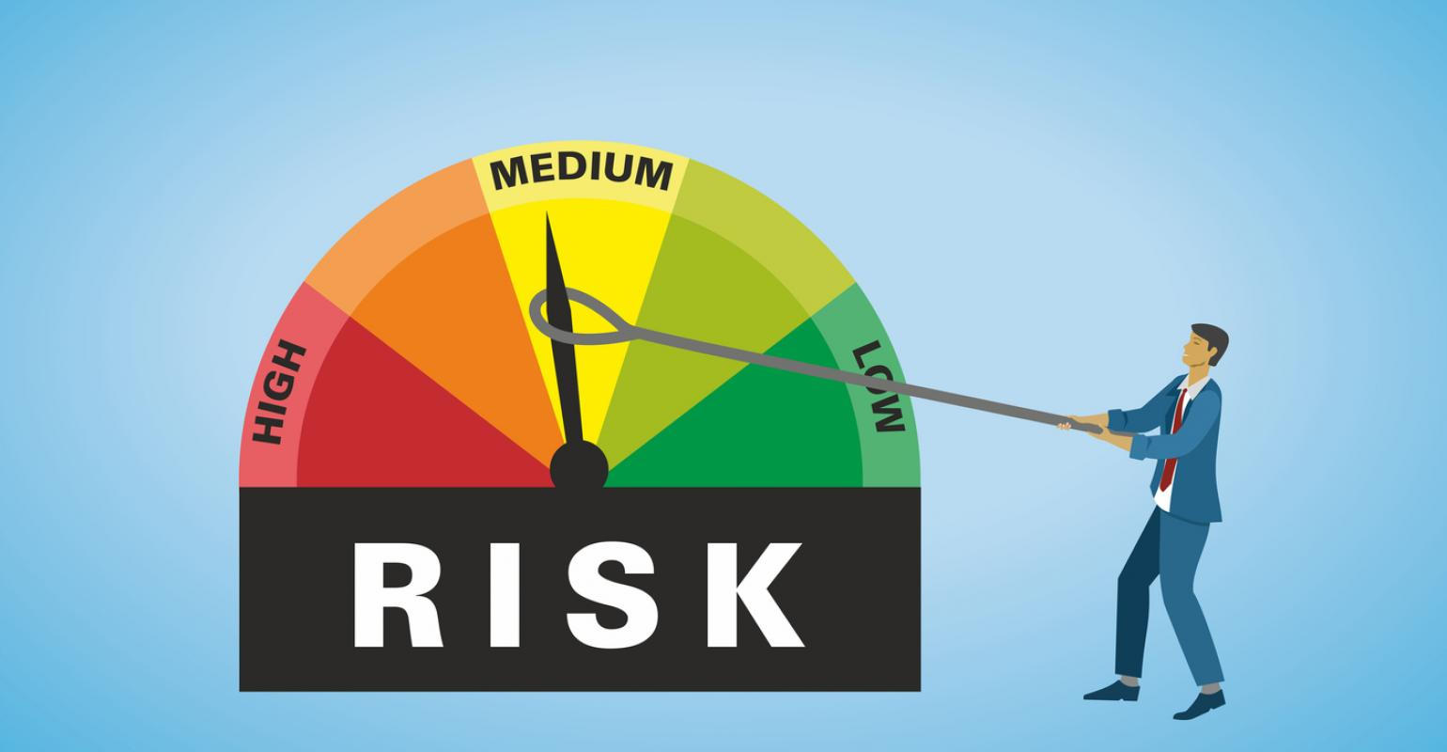
What is Risk Management?
Risk management is the process of identifying, assessing, and controlling potential risks that could impact a project's success. It involves analyzing the likelihood and potential impact of each risk, and developing strategies to mitigate or avoid them.
In project management, risk management plays a critical role in ensuring that projects are completed on time, within budget, and with expected outcomes.
By identifying and managing risks early on, project managers can proactively address potential issues and minimize their impact on the project's success.

Slide 49
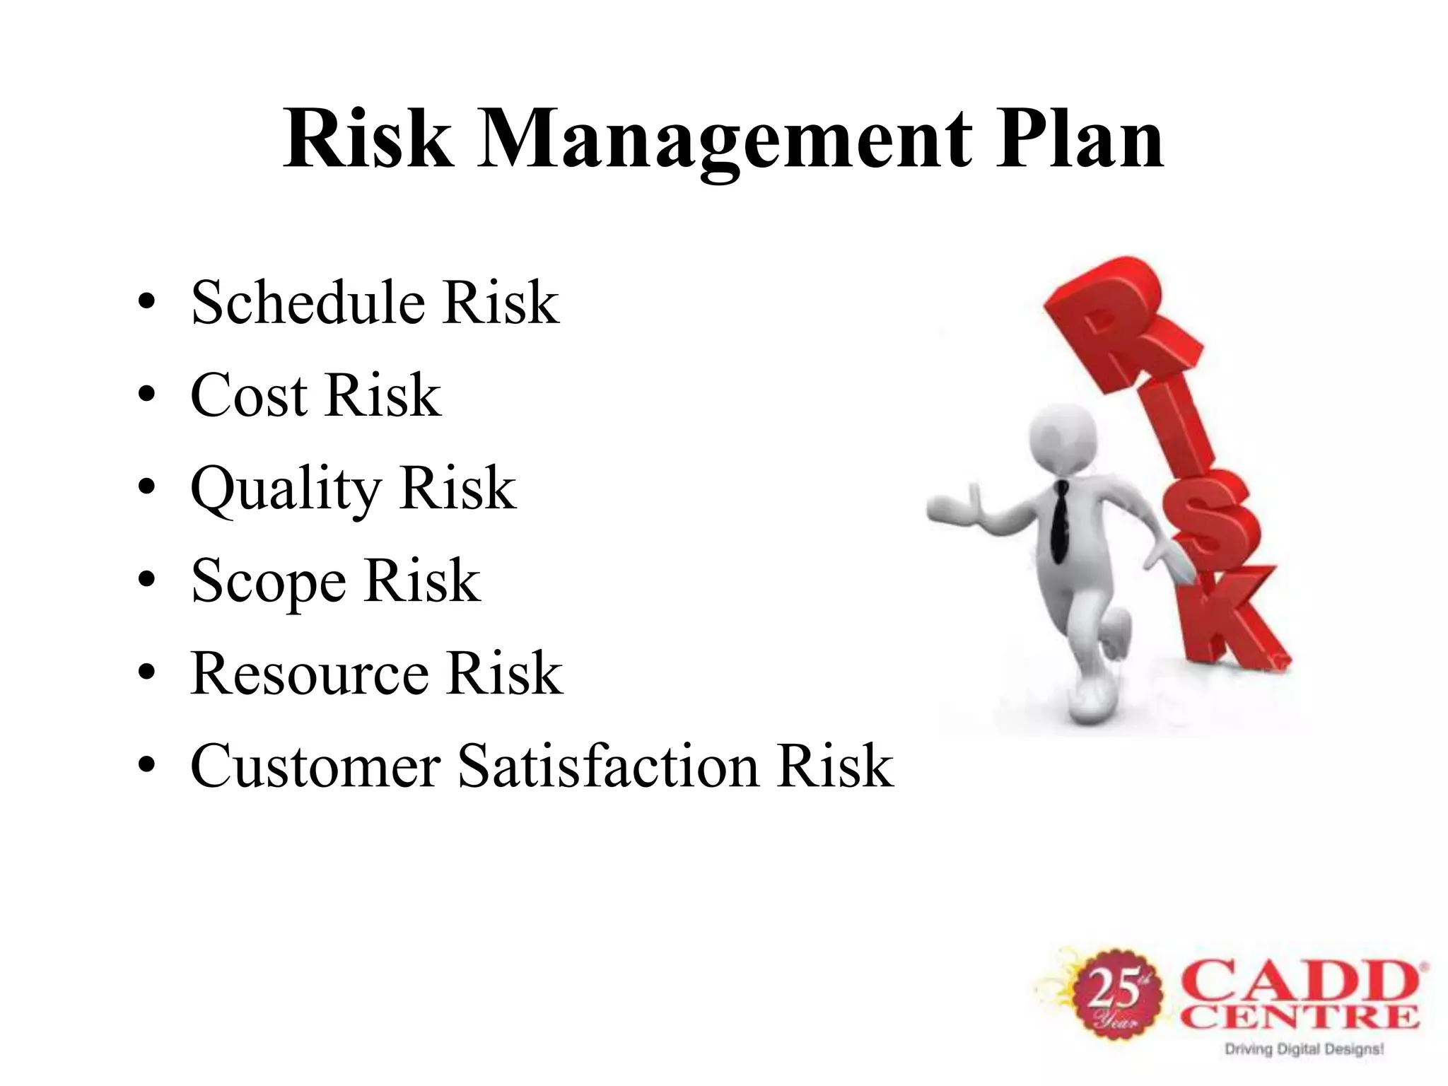

Slide 50
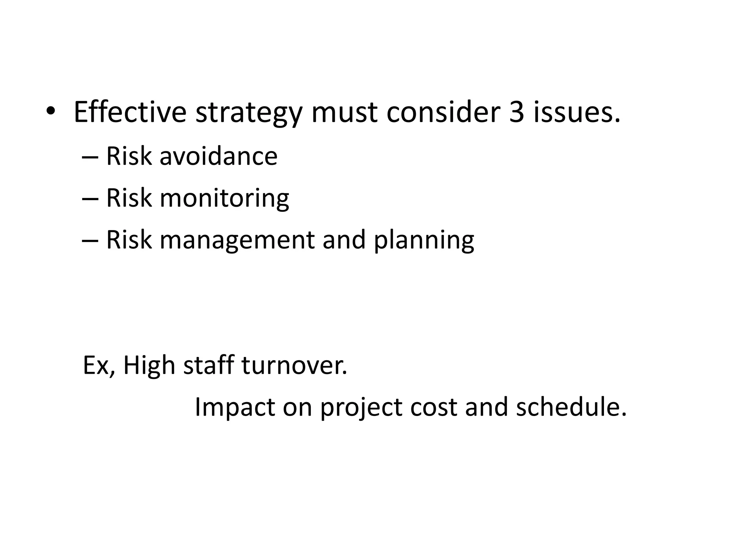
What is RMMM?
1. RMMM stands for "Risk Mitigation, Monitoring, and Management."
2. It refers to a process or strategy used to identify and address risks in a project or organization.
3. The goal of RMMM is to minimize the negative impact of potential risks by developing proactive measures and constantly monitoring and managing them throughout the project or organizational life cycle.

Slide 51
Risk Mitigation
The process of minimizing the impact or likelihood of potential risks.
Recognize and identify potential risks that could affect a project or organization.
Assess the severity and probability of the identified risks.
Risk Monitoring
The ongoing process of observing and tracking identified risks in a project or organization.
Regularly evaluate the current status of identified risks.
Monitor any changes or developments related to the identified risks.
Risk Management
Systematically identifying, analyzing, and responding to risks.
Create a comprehensive plan for managing risks.
Assess and prioritize risks based on their significance and potential impact.
Put in place measures to mitigate identified risks.
Continuously monitor and adjust risk mitigation measures.
Capture and document insights from risk management experiences.
Continual improvement

Slide 52
Risk Plan Script
1. Identify risks
2. Assess the risks
3. Minimise or eliminate risks
4. Assign responsibility for tasks
5. Develop contingency plans
6. Communicate the plan and train your team
7. Monitor for new risks

Slide 53
Risk Plan:
A risk plan is a list of all risks that threaten the project, along with a plan to mitigate some or all of those risks.
This is how we came up with our risk plan :
Brainstorm potential risks:
Two Members from the group of our project set for a brainstorming session to find out the risks or potential occurrences. A total of four potential risks have been found from that session. We got the first potential risk that is, Job seekers who go to online sites to look for jobs can run into a considerable risk of having their personal information hacked. The second potential risk is, At any time, anyone from the developer team can become sick or can leave the job. The third risk identified is, At any time, the system’s code can crash. And the last potential risk has
been recognized that is: Buyer can change their requirement at any time.
Estimate the impact of each risk:
Estimation for the impact of risk contains two parts. One is the Probability of happening that risk and the other one is the impact of that risk. The multiplication of those two parts gives priority determining values to decide which of those risks should be considered most important. Members of the group proposed their estimation and finally, we got priority values 15, 12, 10, and 5 respectively for risk one to risk four.

Slide 54
Build the risk plan:
We Proposed a solution for risk (1) and that is, 2 member will implement the encryption throughout the system’s database. For risk (2) solution is “WE will hire a developer for that position to ensure continuous development.” For risk (3) “We will use their machine as backup servers to reduce the amount of loss.” for risk (4) “All members of the developer team will always be ready to modify the system if possible. Otherwise, Team will convenience the buyer to not to do that”

Slide 55
Risk Plan Table
Possible Risks | prob. | impact | priority | Actions
1. Job seekers who go to online sites to look for jobs run a considerable risk of having their personal information hacked. | 3 | 5 | 15 | We will implement the encryption throughout the system’s database. And will promote the encryption feature by giving proper information in the ABOUT section of the system.
2. At any time, anyone from the developer team can become sick or can leave the job. | 4 | 3 | 12 | We will hire a developer for that position to ensure continuous development.
3. At any time, the system’s code can crash. | 3 | 4 | 10 | We will use their machine as backup servers to reduce the amount of loss.
4. Buyer can change their requirement at any time. | 5 | 1 | 5 | All members of the developer team will always be ready to modify the system. Otherwise, we will convenience the buyer not to do that.

Slide 56
Thank you

